Slide 1
Modelling nephrons and kidney organoids via Polarized Adhesion

Slide 2
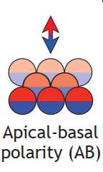
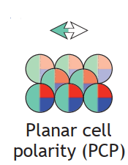
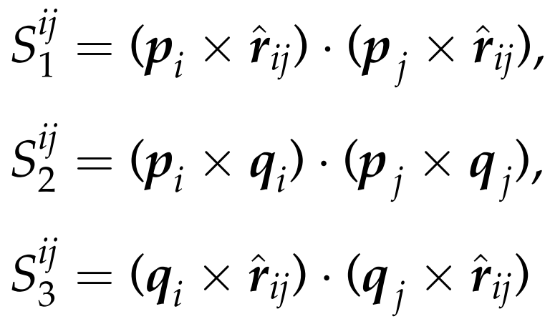
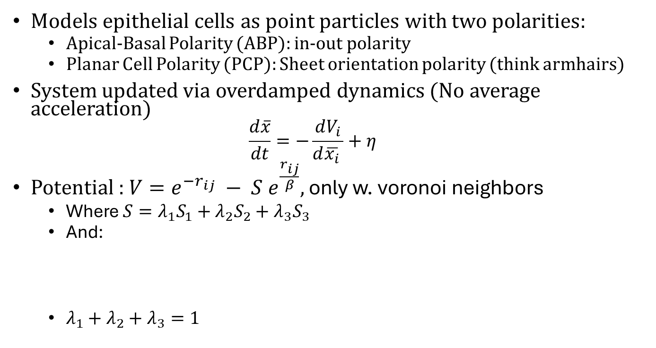
Main model
Models epithelial cells as point particles with two polarities:
Apical-Basal Polarity (ABP): in-out polarity
Planar Cell Polarity (PCP): Sheet orientation polarity (think armhairs)
System updated via overdamped dynamics (No average acceleration)
$$\frac{d\overline{x}}{dt}=−\frac{dV_{i}}{d\overline{x_{i}} }+η$$
Potential : $V=e^{−r_{ij}} − S e^{\frac{r_{ij}}{β}},$ only w. voronoi neighbors
Where $S=λ_{1}S_{1}+λ_{2}S_{2}+λ_{3}S_{3}$
And:
$λ_{1}+λ_{2}+λ_{3}=1$

Slide 3
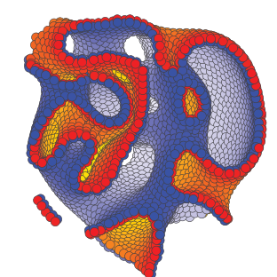
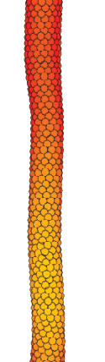
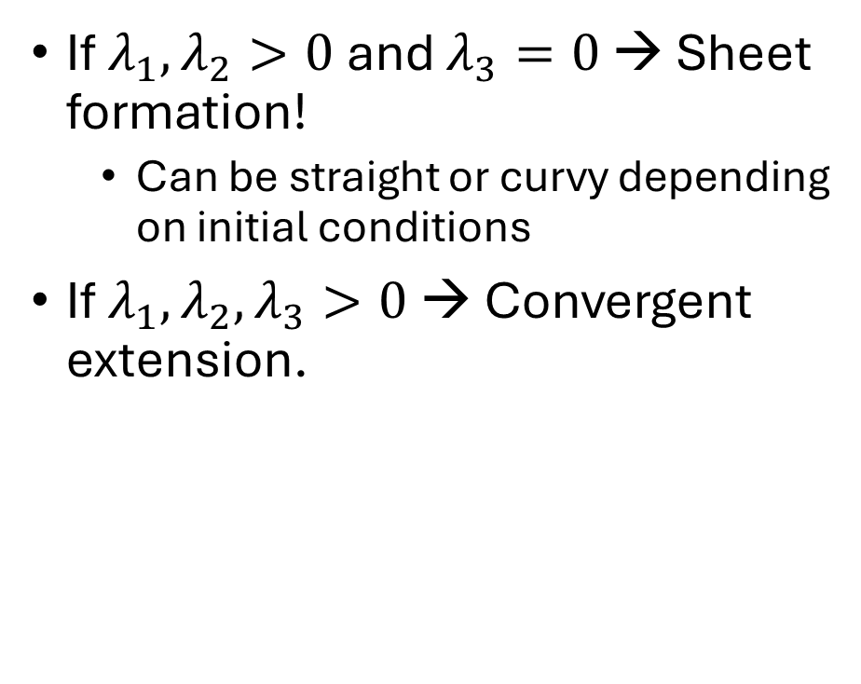
Effects of main model
If $λ_{1},λ_{2}>0$ and $λ_{3}=0$ → Sheet formation!
Can be straight or curvy depending on initial conditions
If $λ_{1},λ_{2},λ_{3}>0$ → Convergent extension.

Slide 4
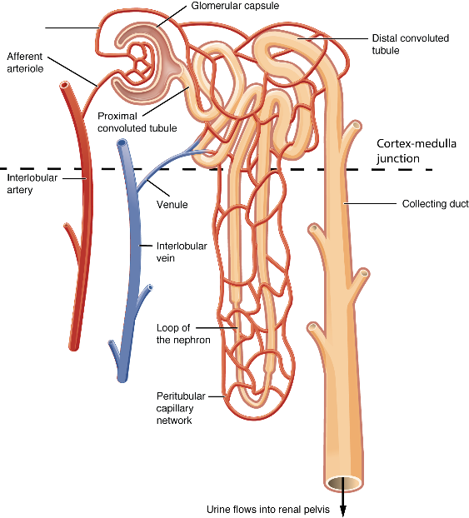
Nephrons – What are they?
Functional unit of the kidney
Filters blood and creates primary urine
Consists of:
Renal Corpuscle:
Glomerulus
Bowman’s capsule
Function: Blood is filtered as passed through capillary walls
Renal tubule:
Convoluted tubes
Loop of Henle
Collecting tubule
Aim of this project: Creating glomerulus and tubuli

Slide 5
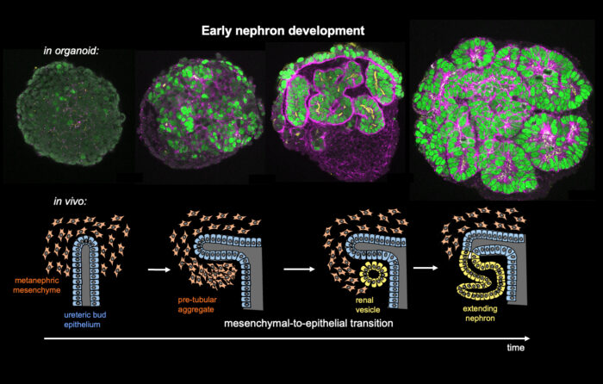
Kidney Organoids
In vitro models of kidney parts like nephrons
Formed from human pluripotent stem cells (hPSCS) → cap mesenchyme cells → epithelilal cells which forms the nephrons
Steps: Preferential adhesion →vesicle formation → tube formation
Problems: Concentration between cell types.
E/M > 1 → Too interconnected network / tubes open up
E/M < 1 → Too few tubes

Slide 6
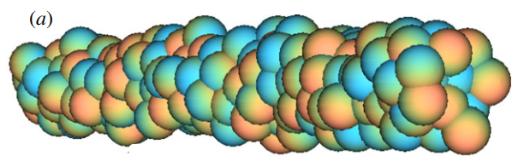
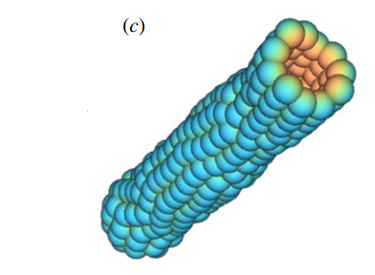
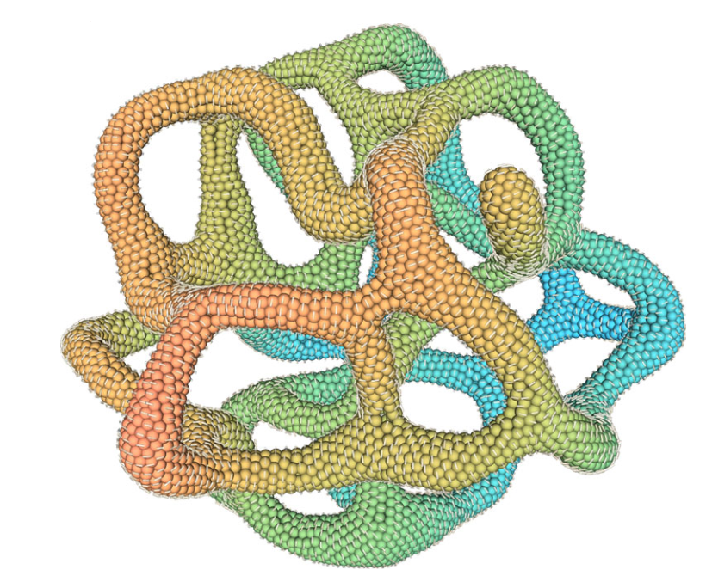
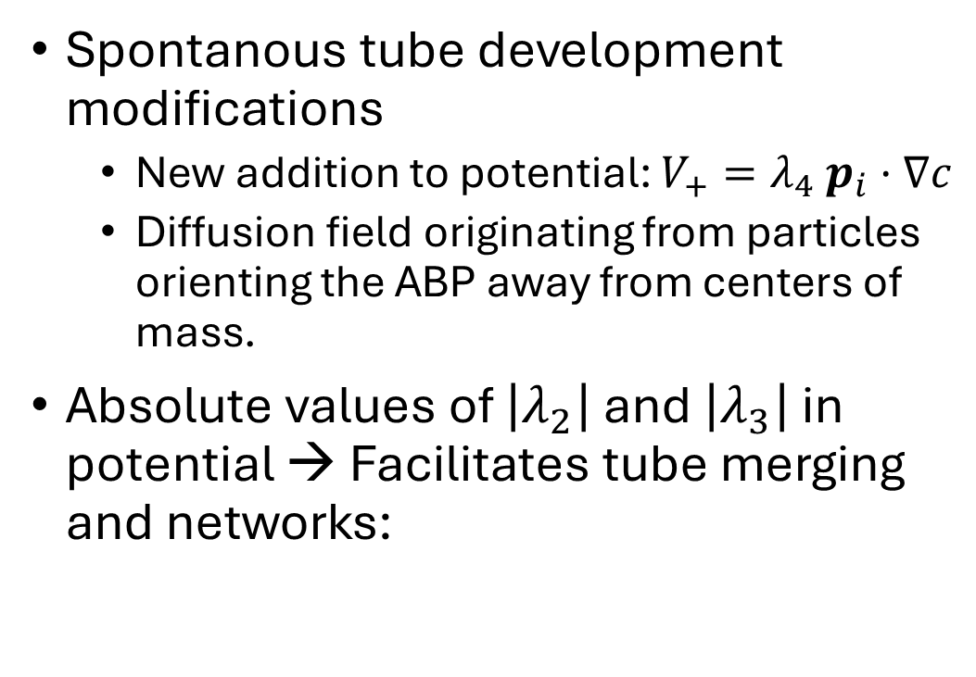
Modifications for tubes and network
Spontanous tube development modifications
New addition to potential: $V_{+}=λ_{4} p_{i}·∇c$
Diffusion field originating from particles orienting the ABP away from centers of mass.
Absolute values of $\left|λ_{2}\right|$ and $\left|λ_{3}\right|$ in potential → Facilitates tube merging and networks:

Slide 7
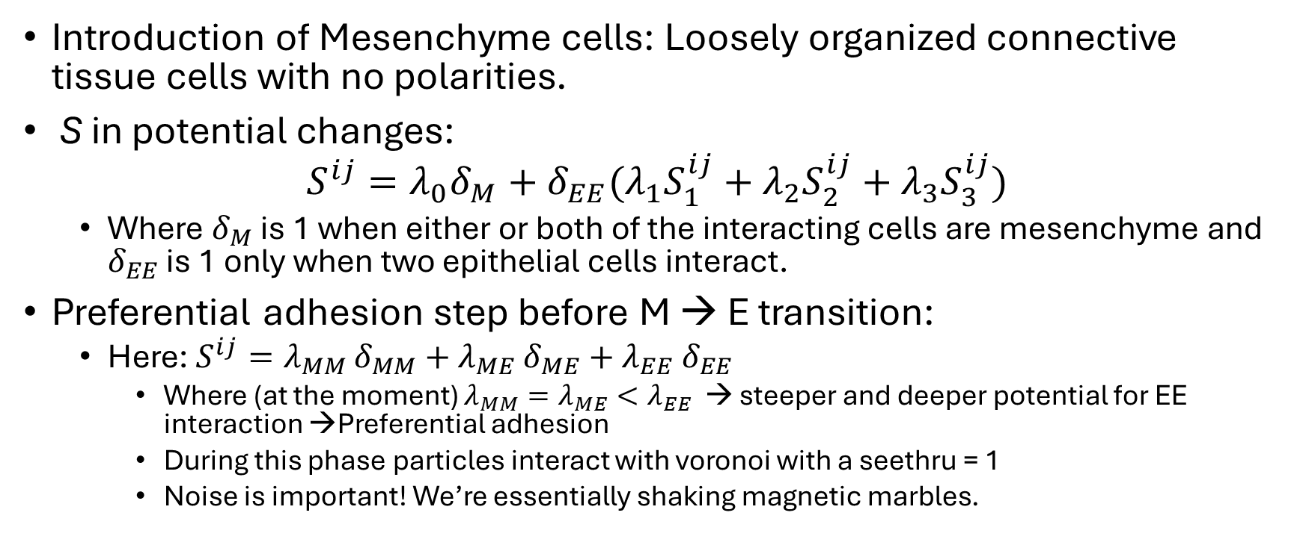
Modifications for Nephron organoid formation
Introduction of Mesenchyme cells: Loosely organized connective tissue cells with no polarities.
S in potential changes:
$$S^{ij}=λ_{0}δ_{M}+δ_{EE}(λ_{1}S_{1}^{ij}+λ_{2}S_{2}^{ij}+λ_{3}S_{3}^{ij})$$
Where $δ_{M}$ is 1 when either or both of the interacting cells are mesenchyme and $δ_{EE}$ is 1 only when two epithelial cells interact.
Preferential adhesion step before M → E transition:
Here: $S^{ij}=λ_{MM}$ $δ_{MM}+λ_{ME} δ_{ME}+$ $λ_{EE} δ_{EE}$
Where (at the moment) $λ_{MM}=λ_{ME}<λ_{EE}$ → steeper and deeper potential for EE interaction →Preferential adhesion
During this phase particles interact with voronoi with a seethru = 1
Noise is important! We’re essentially shaking magnetic marbles.

Slide 8
Results so far - Qualitatively
I’m gonna make you all seasick now.

Slide 9
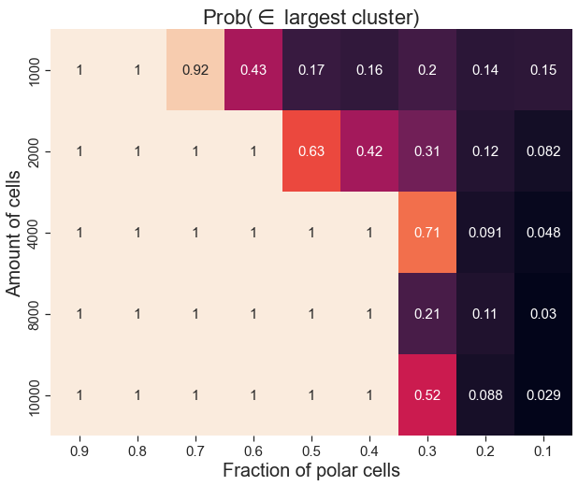
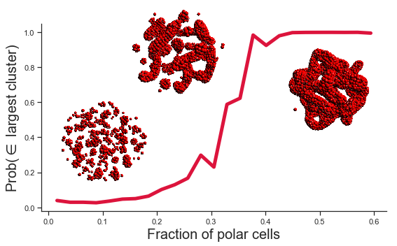
Percolation (1) – Without cell division
Percolation: Probability of belonging to the largest cluster.
Without cell-proliferation:

Slide 10
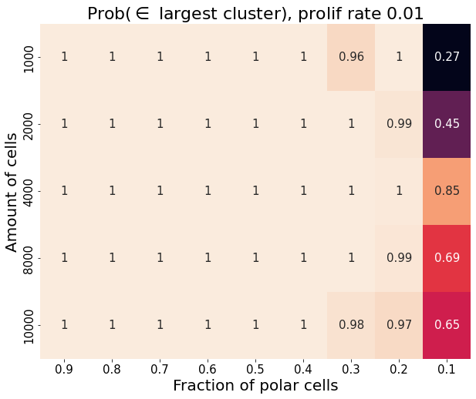
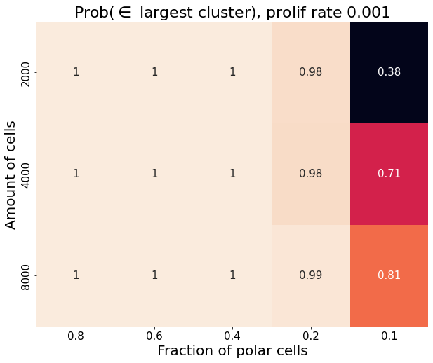
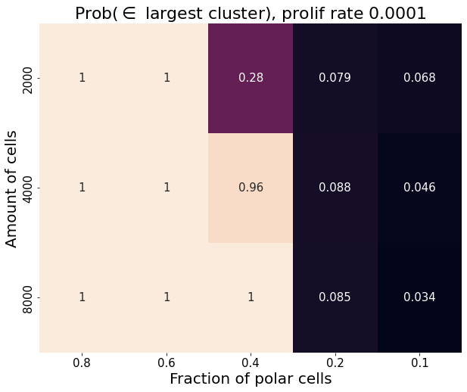
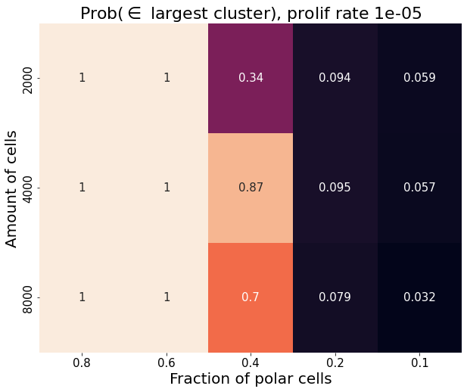
Percolation (2) – With cell division

Slide 11
Reducing networks to graphs
Method:
Find nearest 5 voronoi neighbors of all particles
Sample random E-cells and combine with all E-cells in radius of 5-8 around it.
Update neighbors such that all old connections are maintained.
Repeat steps 2 and 3 until no new mergings happens.
Remove 3-cycles from the resulting graph.

Slide 12
Reducing networks to graphs results
Seasickness 2: Electric Boogaloo.

Slide 13
Work to be done
Mesenchyme → Epithelial: Add additional and/or gradual conversion
Model nephron formation more ‘hands on’ (not modelling petri-dish organoids)
Finishing the script for Network conversion
Inhibit tube fusions

